Slide 1
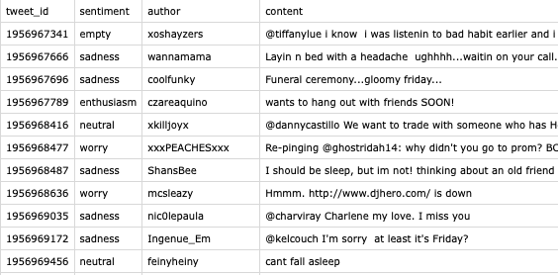
Dataset
Dataset from RoBERTa
40000 Line items
4 Attributes (tweet_id, sentiment, author, content)
Three Use cases:
1. To determine whether the sentences have emotion and pick out the sentences that have emotion.
2. To fine tune the model we build.
3. To test the result given by our model after depolarization in order to judge the performance of our model

Slide 2
Future Work
After evaluating our results with RoBERTa
We intend to further evaluate our result manually:
Set up new questionnaires contains the same tweets after replacing polar vocabulary:
1. Interviewees are asked to score the polarization level of the tweets again.
2. Interviewees are asked to rank the understandability of the sentences.
If the average polarization level of feedback from questionnaires would be reduced significantly
after using the depolarization system, it could demonstrate our system’s success.

